Slide 1
Convolutional Sequence to Sequence Learning
Jonas Gehring, Michael Auli, David Grangier, Yann N. Dauphin Facebook AI Research
2020-03-12
JuHyoung Kim
kjhkjh75@naver.com

Slide 2
-INTRODUCTION
Sequence to sequence learning has been successful in many tasks
The dominant approach is the RNN using soft-attention mechanism.
RNN vs CNN
Trend | Commonly used | Less common
representation | Not fixed size context | Fixed size context
Dependency time step | Depend on the computations of the previous time step | Do not need depend on the computations of the previous time step
parallelization | Prevent parallel computation | Allow parallelization
Complexity(k:kernel width) | O(n) | O(n/k)
Learning | harder | Easier

Slide 3
- Introduction
Sequence to sequence using CNN model
Gated linear units(GLU)
Residual connections.
Attention
Position Embeddings
Convolutional Block structure
Multi-step Attention

Slide 4
- Term
Gated linear units (Dauphin et al., 2016)
Residual connections(He ea al., 2015)
Attention.

Slide 5
- A convolutional Architecture
Position Embeddings
Input X X = (x1,….,xm)
-> Embedding vector W = (w1,….,wm)
Absolute position vector P = (p1,….,pm)
Representation vector E = (w1+p1,….,wm+pm)

Slide 6
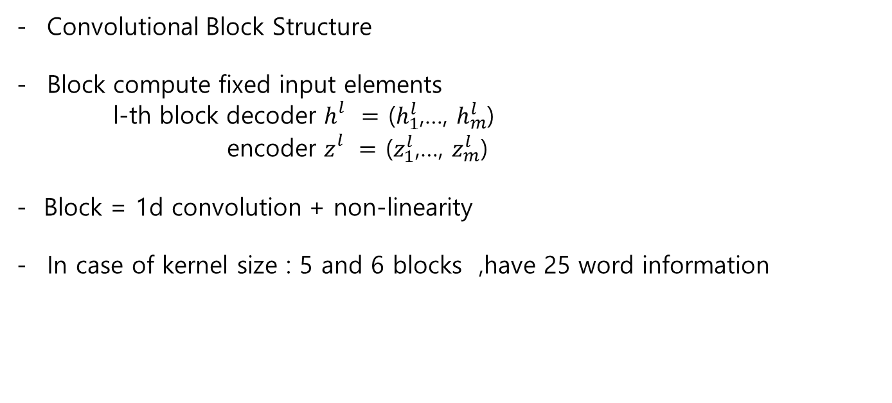
- A convolutional Architecture
Convolutional Block Structure
Block compute fixed input elements
l-th block decoder $h_{}^{l}=$ ($h_{1}^{l}$,…, $h_{m}^{l}$)
encoder $z_{}^{l}=$ ($z_{1}^{l}$,…, $z_{m}^{l}$)
- Block = 1d convolution + non-linearity
In case of kernel size : 5 and 6 blocks ,have 25 word information
Plus 4 words information more.

Slide 7
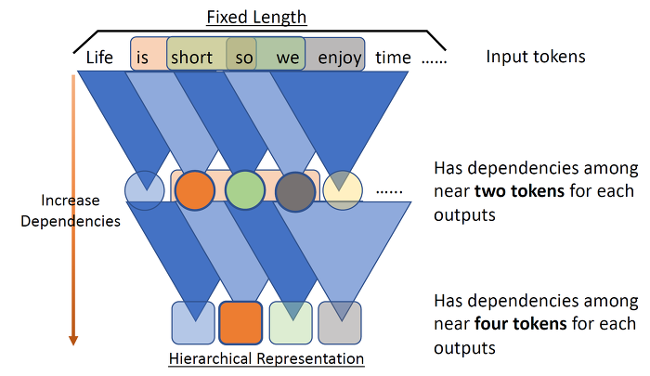
- A convolutional Architecture
Convolutional Block Structure
Kernel Size : 3
More stacking, More considering about Dependency of sentences
To protect loss of information about first and end words.
-> use padding to maintain length of sequences.

Slide 8
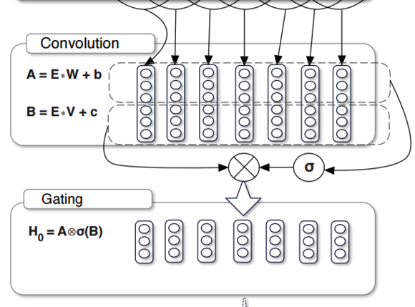

- A convolutional Architecture
- Gate linear Unit(GLU)
- Control the information entrance.
- Element-wise multiplication
- Both sigmoid and tanh available
Author told that sigmoid was better performance.

Slide 9
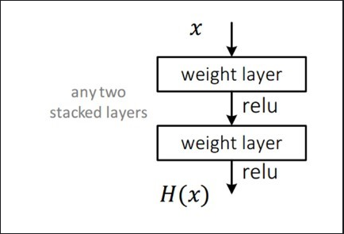
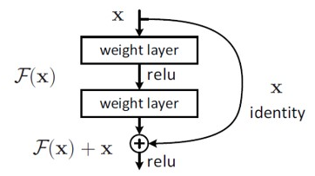
- A convolutional Architecture
- Residual Connection.

Slide 10
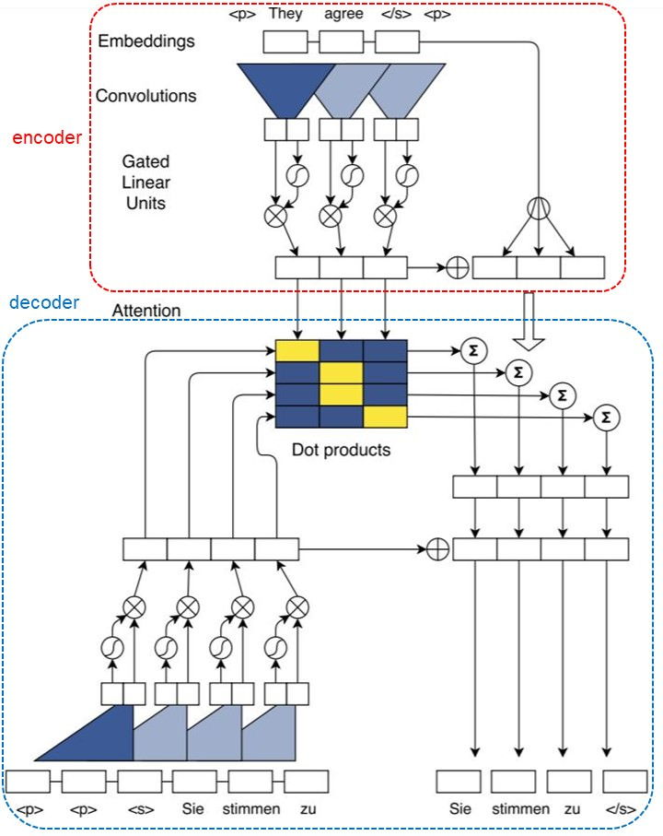
- Mechanism

Slide 11
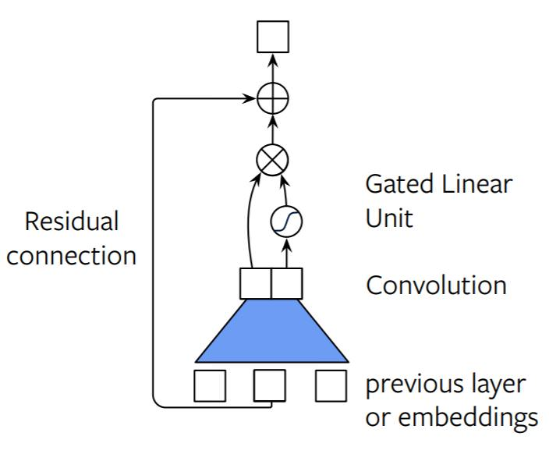
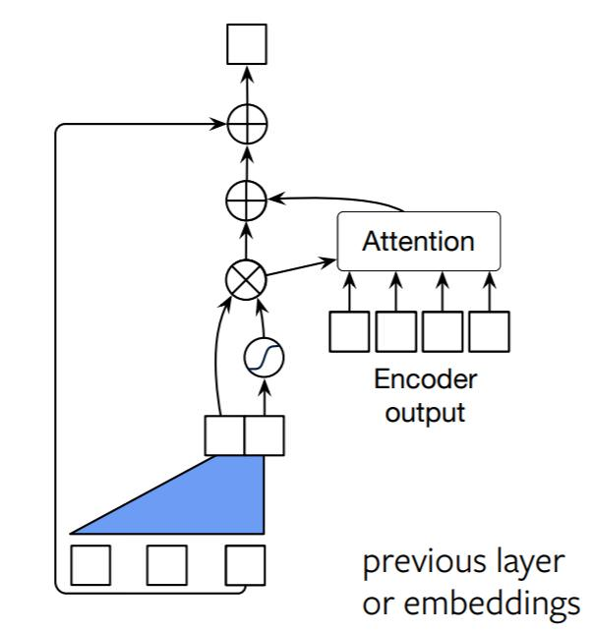
- Mechanism

Slide 12
Result
BLEU
1) Measure how similar machine translation with human`s translation
2) No dependency of languages.
3) Higher score, Better performance.
PPL
1) How many candidate in specific step.
2) Comparing more than two languages model, it could be useful.
3) Lower score, Better performance.

Slide 13
Result
BPE
1) Find most frequency of bigram.
2) Merge bigram to one unit.
3) repetition.
aaabdaaabac
->ZabdZabac Z=aa
->ZYdZYac Y=ab Z=aa
->XdXac X=ZY Y=ab Z=aa

Slide 14
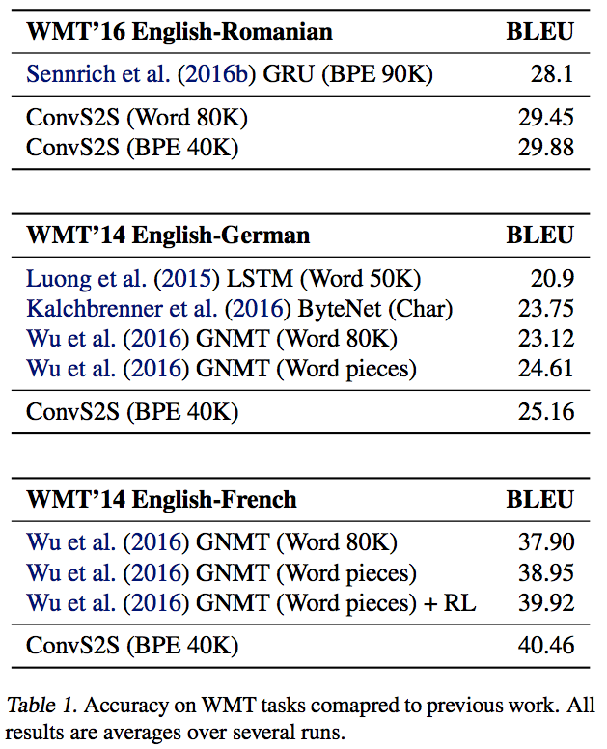
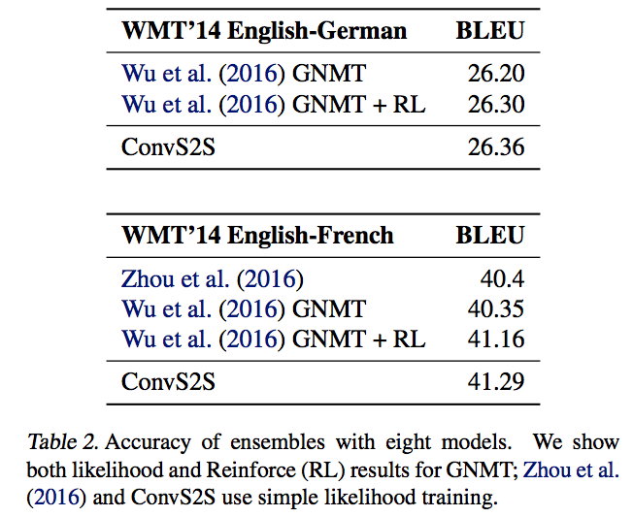
Result

Slide 15
Future work
Using cnn model to apply with sequenceR
Research for ensemble model

